Slide 1


File System API
SE3331-1 (2026 Fall)
IPADS, Shanghai Jiao Tong University
https://www.sjtu.edu.cn

Slide 2
Review: Large-scale websites on distributed systems
While distributed systems are built from components on a single node
  File system runtimes, etc.
Caching server
Caching server
Caching server
…
Caching
Caching
Caching
Distributed caching
Database server
Database server
CDN
Users
Application #1
generate the page
Database
user, price
…
Database
user, price
Application server
Distributed database
Internet
Load
Balance
Application #2
add the order
File server
File server
File server
File:
image
File:
image
…
File:
image
Application server
…
…
Message queue
Distributed file system

Slide 3
Review: Large-scale websites on distributed systems
While distributed systems are built from components on a single node
  File system runtimes, etc.
Caching server
Caching server
Caching server
…
Caching
Caching
Caching
Distributed caching
Database server
Database server
CDN
Users
Application #1
generate the page
Database
user, price
…
Database
user, price
Application server
Distributed database
Internet
Load
Balance
Application #2
add the order
File server
File server
File server
File:
image
File:
image
…
File:
image
Application server
…
…
Message queue
Distributed file system

Slide 4
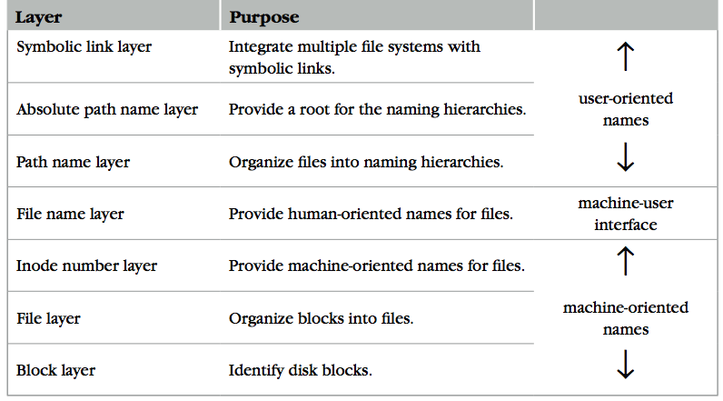
Review: The Naming Layers of the UNIX FS (version 6)
Notes:
TODO: redraw

Slide 5
Review: inode for Larger Files
File
(inode)
Block num
Disk
Block
block
indirect block
double indirect block
triple indirect block
Data
Data
Data
Data
an inode
Data
Data
Notes:
with a 512 byte block size, and 4 byte block pointers, each indirect block can consist of 128 (512 / 4) pointers.
For one double indirect block: (128*128*512) / (1024*1024)
页表的indirection vs. block indirection

Slide 6
Review: L4: File Name Layer
File
name
Inode num
File
(inode)
Block num
Disk
Block
File name
  Hide metadata of file management
  Files and I/O devices
Mapping
  Mapping table is saved in directory
  Default context: current working directory
    Context reference is an inode number
  Question: where can we store the directory?
    Method: the current working directory is also a file
struct inode
integer block_nums[N]
integer size
integer type
Overview of a directory inode content
File name | inode num
helloworld.txt | 12
cse2021.md | 73
procedure name_to_inode(string filename, integer dir)-> integer
return LOOKUP(dir, filename)

Slide 7
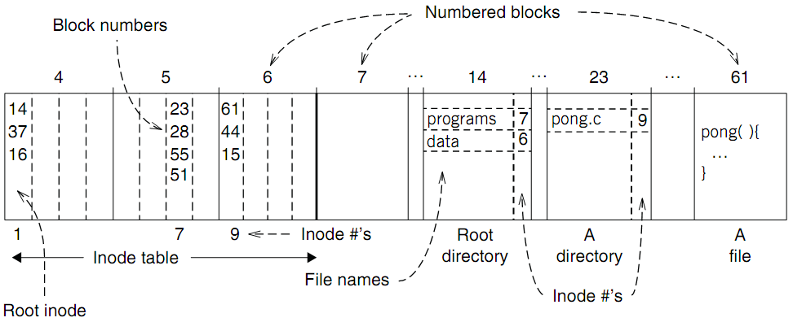
An Example: Find Blocks of "/programs/pong.c"
Find data of block 61 by its block number
  And data of block 44 & 15

Slide 8
L7: Symbolic
Link Layer
Symbolic link
Absolute path
File
name
Inode num
File
(inode)
Block num
Disk
Block
Path name
Name files on other disks
  Inode is different on other disks
  Supports to attach new disks to the name space
Two options
  Make inodes unique across all disks (not good)
  Create synonyms for the files on the other disks
Introducing layer 7: soft link (symbolic link)
  SYMLINK
  Add another type of inode

Slide 9
Directly Dump a Symbolic Link
$ ln -s "/tmp/abc" s-link
$ ls –l s-link
7536945 lrwxrwxrwx 1 xiayubin 8 Sep 20 08:01 s-link -> /tmp/abc
$ readlink s-link
/tmp/abc
$ cat s-link
cat: slink: No such file or directory
$ echo "hello, world" > /tmp/abc
$ cat s-link
hello, world
What does "8" means?
File size

Slide 10
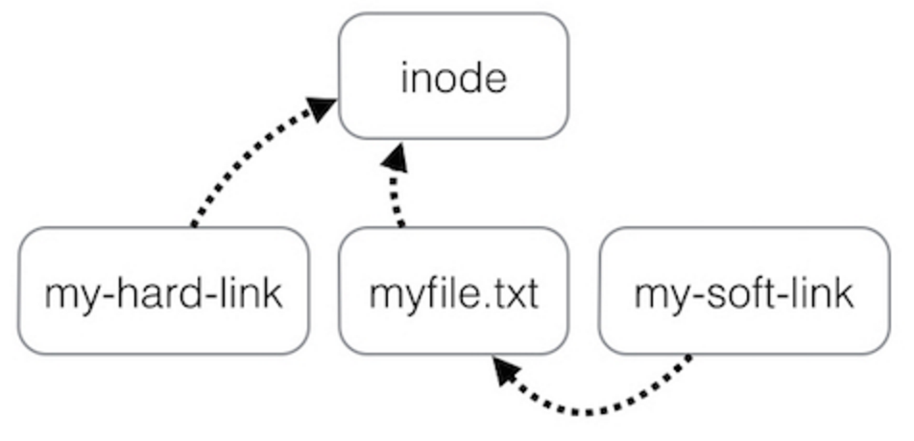
Two Types of Links (Synonyms)
By inode number
By inode number
By file name

Slide 11
Sidebar: Notice the Context Change
Another interesting behavior of soft link
  There is a directory: "/Scholarly/programs/www"
  The root directory contains a soft link
    "/CSE-web" -> "/Scholarly/programs/www"
  Run following commands
    cd CSE-web
    cd ..
  What is the current directory? Why?
    ".." is resolved in a new default context: by bash, not file system

Slide 12
Sidebar: Notice the Context Change
The bash tries to be "human-friendly"
  When you cd /into/a/symlink/, the shell remembers the old location (in $OLDPWD) and will use that directory when you cd .. under the assumption that you want to return to the directory you were just in
If you want to use the real .., then you must also use "cd -P .."
The -P option says to use the physical directory
structure instead of following symbolic links (see
also the -P option to the set built-in command);
the -L option forces symbolic links to be followed.
$ cd
$ cd a/b/symlink
$ cd -P ..
$ pwd -P
/home/sarnold
$

Slide 13
Summary of File System's 7 Layers
File name is not part of a file
  Name is not a part of an inode
  Name is data of a directory, and metadata of a file system
  One inode can have several names (hard links)
Hard links are equal
  If a file has two names, both are links (instead of "a link and a name")
Directory size is small
  Only mapping from name to inode number
  The term "folder" is somewhat misleading

Slide 14
Implementing the file system API

Slide 15
Implementing the File System API
API
  CHDIR, MKDIR
  CREAT, LINK, UNLINK, RENAME
  SYMLINK
  MOUNT, UNMOUNT
  OPEN, READ, WRITE, APPEND, CLOSE
  SYNC
Implemented as system calls to user applications
  Kernel has many sets of function pointers implementing the API
  Each set is specific to a FS (chose at mount point)

Slide 16
Sidebar: open() vs. fopen()
Difference between open() and fopen()?
  open() returns an fd; fopen() return a FILE*
  open() is a system call of OS; fopen() is an API of libc
Questions
  Which one can be used on both Windows and Linux?
  Which one has better performance?
    fopen() provides you with buffering I/O that may turn out
    to be a lot faster than what you're doing with open()
Notes:
What is the difference between FILE* and fd? Fopen and open?

Slide 17
File Meta-data -- inode
Owner ID
  User ID and group ID that own this inode (can be changed by chown)
Types of permission
  Owner, group, other
  Read, write, execute
Time stamps
  Last access (by READ)
  Last modification (by WRITE)
  Last change of inode (by LINK)
struct inode
integer block_nums[N]
integer size
integer type
integer refcnt
integer userid
integer groupid
integer mode
integer atime
integer mtime
integer ctime
Notes:
There are three more mode bits: setuid, setgid, stick_bit

Slide 18
OPEN a File
Check user's permission
Update last access time
Return a short name for a file
  File descriptor (fd)
  fd is used by READ, WRITE, CLOSE, etc.

Slide 19
File Descriptor
Each process starts with three default open files
  Standard in(stdin): fd = 0,
  standard out(stdout): fd = 1,
  standard error(stderr): fd = 2
Can also use fd to name opened devices
  Keyboard, display, etc.
  Allow a designer not to worry about input/output
    Just read from fd 0 and write to fd 1
Each process has its own fd name space
Notes:
What is the different between fd and inode?
More details on device as a file

Slide 20
Why File Descriptor?
Other options
  Option-1: OS returns an inode pointer
  Option-2: OS returns all the block numbers of the file
Reasons and considerations
  Security: user can never access kernel's data structure
  Non-bypassability: all file operations are done by the kernel
    Aka., complete mediation

Slide 21
File Cursor
File cursor
  Keep track of operation position within a file
  Can be changed by the SEEK operation
Case-1: Sharing file cursor
  Parent passes its fd to its child
    In UNIX, a child process inherits all open fds from its parent
  Allow both parent and child to share one output file
Case-2: Not sharing file cursor
  Two processes open the same file
Cursor

Slide 22
fd_table & file_table
One file_table for the whole system
  Records information for opened files
  inode num, file cursor, ref_count of opening processes
  Children can share the cursor with their parent
One fd_table for each process
  Records mapping of fd to index of the file_table

Slide 23
File Cursor Sharing
Note: this refcnt is not the refcnt of inode!
fd_table
file_table
fd
index
index
inode num
file cursor
refcnt
Process A
3
115
115
23
128
1
116
23
240
2
fd
index
Process B
3
116
...
fd
index
C is B's child
3
116
Process A, B and C all open just one file with inode number 23
Process A and B open the same file, not share file cursor
Process B and C share the file cursor

Slide 24
OPEN Implementation
procedure OPEN(string filename, integer flags, integer mod)-> integer
0 inode_number ← PATH_TO_INODE_NUMBER(filename, wd)
if inode_number = FAILURE and flags = O_CREATE then // Create the file?
inode_number ← CREATE(filename, mode) // Yes, create it.
if inode_number = FAILURE then
return FAILURE
inode ← INODE_NUMBER_TO_INODE(inode_number)
if PERMITTED(inode, flags) then // Does this user have the required permissions?
file_index ← INSERT(file_table, inode_number)
fd <- FIND_UNUSED_ENTRY(fd_table) // Find entry in file descriptor table
fd_table[fd] ← file_index // Record file index for file descriptor
return fd // Return fd
else return FAILURE // No, return a failure

Slide 25
READ Implementation
procedure READ(integer fd, character[] &buf, integer n)-> integer
0 file_index ← fd_table[fd]
cursor ← file_table[file_index].cursor
inode ← INODE_NUMBER_TO_INODE(file_table[file_index].inode_number)
m ← MINIMUM(inode.size – cursor, n)
atime of inode ← now()
if m = 0 then return END_OF_FILE
for i from 0 to m – 1 do
b ← INODE_NUMBER_TO_BLOCK(cursor + i, inode_number)
COPY(b, buf, MINIMUM(m-i, BLOCKSIZE)
i ← i + MINIMUM(m – i, BLOCKSIZE)
file_table[file_index].cursor ← cursor + m
return m

Slide 26
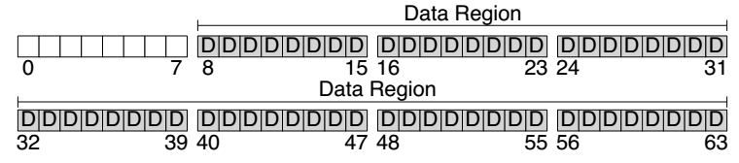
Disk Layout of a Simple File System

Slide 27
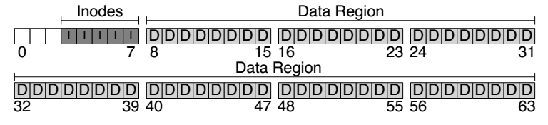
At the Head of a Disk Partition
S
i
d
i: inode free block bitmap
d: data free block bitmap
S: super-block
  How many inodes: 80
  How many data blocks: 56
  Where the inode table begins: block 3
  …
  A magic number to identify the file system type
The super-block is used when
the file system is mounted

Slide 28
Questions
How many read and write in a OPEN?
How many read and write in a READ?
How many read and write in a CREATION?

Slide 29
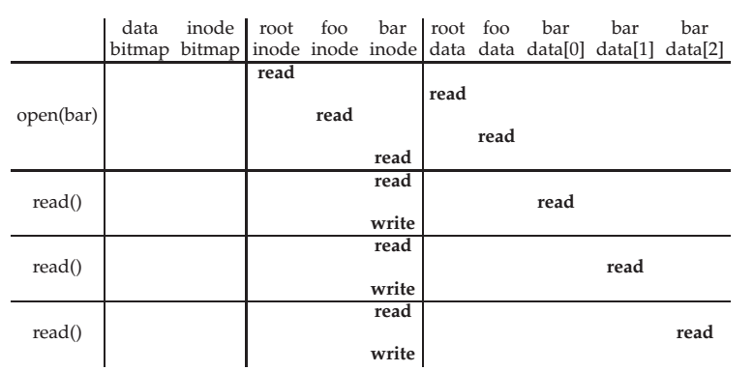
File Open & Read Timeline
open("/foo/bar", O_RDONLY)
Why "write" on bar inode in a read operation? Why no "write" on foo inodes?

Slide 30
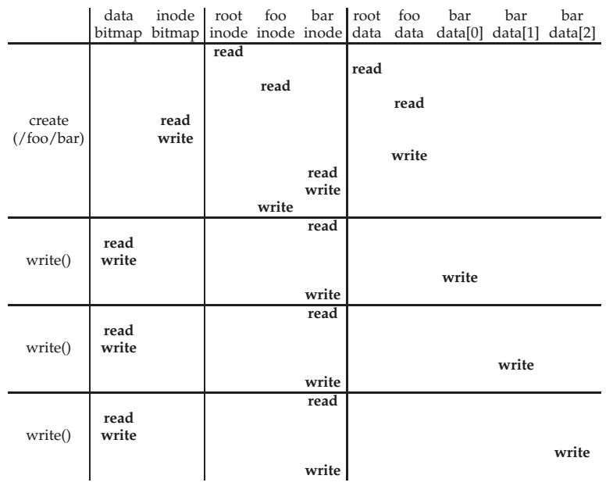
File Creation Timeline

Slide 31
WRITE, APPEND & CLOSE
WRITE is similar to READ
  Allocate new block if necessary
  Update inode's size and mtime
APPEND
  Similar to write, directly write to the end of the file
CLOSE
  Free the entry in the fd_table
  Decrease the reference counter in file table
  Free the entry in file table if counter is 0
Failures in the middle may cause inconsistency!

Slide 32
Questions
When writing, which order is preferred?
  Update block bitmap, write new data, update inode (size and pointer)
  Update block bitmap, update inode (size and pointer), write new data
  Update inode (size and pointer), update block bitmap, write new data

Slide 33
SYNC
Block cache
  Cache of recently used disk blocks
  Read from disk if cache miss
  Delay the writes for batching
  Improve performance
  Problem: may cause inconsistency if fail before write
SYNC
  Ensure all changes to a file have been written to the storage device

Slide 34
Delete after OPEN but before CLOSE
One process has OPENed a file
Another process delete the file
  By removing the last name pointing to the file
  The reference counter is now 0
The inode is not freed until the first process calls CLOSE
  On Windows, it may forbid to delete an opened file

Slide 35
Review: Renaming
1 UNLINK(to_name)
2 LINK(from_name, to_name)
3 UNLINK(from_name)
❌
Text edit usually save editing file in a temp file
  Edit in .a.txt.swp, then rename .a.txt.swp to a.txt
What if the computer fails between 1 & 2?
  The file to_name will be lost, which will surprise the user
  Need atomic action (in later lectures)

Slide 36
Review: Renaming
1 LINK(from_name, to_name)
2 UNLINK(from_name)
Weaker specification without atomic actions
  1. Changes the inode # for to_name to the inode # of from_name
  2. Removes the directory entry for from_name
If fails between 1 & 2
  Must increase reference count of from_name's inode on recovery
If to_name already exists
  The to_name file will always exist, even if the machine fails between 1 & 2
  Need to revoke the resource on recovery

Slide 37
Rename between different directories
$ ls -il dir1
40978804 -rw-r--r-- 1 xiayubin wheel 6 9 26 08:50 from.txt
$ ls -il dir2
40978827 -rw-r--r-- 1 xiayubin wheel 7 9 26 08:51 to.txt
$ mv dir1/from.txt dir2/to.txt
$ ls dir1
$ ls -il dir2
40978804 -rw-r--r-- 1 xiayubin wheel 6 9 26 08:50 to.txt
inode number

Slide 38
Renaming
1 UNLINK(to.txt)
2 LINK(from.txt, to.txt)
3 UNLINK(from.txt)
1 LINK(from.txt, to.txt)
2 UNLINK(from.txt)
If to.txt exists and fails between 1 & 2
  The file to.txt will be lost,
  which will surprise the user
If to.txt exists and fails between 1 & 2
  It will always exist even if the machine fails between 1 & 2
  Must increase reference count of from.txt's inode on recovery

Slide 39
Other file systems (not inode)

Slide 40
Other Choices instead of inode
Method-1: use continue blocks
  Re-allocate if the file expands
  E.g., data in memory
  Why not?
Method-2: use a linked list
  Each block links to its next block
  Use special one as EOF (End of File)
  E.g., FAT32
  Why not?
How to integrate different FS?
  vnode (will discuss later)
  Interface is similar with inode

Slide 41
FAT (File Allocation Table) File System
File is a collection of disk blocks
FAT is a linked list 1-1 with blocks
File Number is index of root
of block list for the file
File offset (o = < B, x > )
Follow list to get block #
Unused blocks ⬄ FAT free list
FAT
Disk Blocks
file number
0:
0:
31:
File 31, Block 0
File 31, Block 1
free
File 31, Block 2
N-1:
N-1:
memory

Slide 42
FAT Properties
File is a collection of disk blocks
FAT is a linked list 1-1 with blocks
File Number is index of root
of block list for the file
File offset (o = < B, x > )
Follow list to get block #
Unused blocks ⬄ FAT free list
Ex: file_write(31, < 3, y >)
  Grab blocks from free list
  Linking them into file
FAT
Disk Blocks
file number
0:
0:
31:
File 31, Block 0
File 31, Block 1
File 31, Block 3
free
File 31, Block 2
N-1:
N-1:
memory

Slide 43
FAT File System
File allocation table (FAT)
  Organize files as linked lists
No inode
  File metadata: name & size
  Metadata are saved in dirs

Slide 44
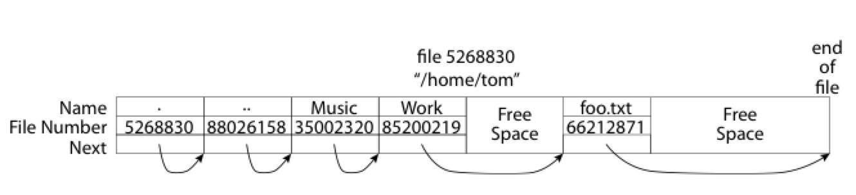
What about the Directory in FAT?
Directory: essentially a file containing <file_name: file_number> mappings
  Free space for new entries
  File attributes (metadata) are kept in directory
  Each directory is a linked list of entries
Question: Where to find root directory ( "/" )?
  Root dir at sector 0

Slide 45
Question: inode vs. FAT
What are the differences between inode and FAT?
Support hard link? Soft link?

